Slide 1
Do not adjust the width of this textbox, just type within it
Introduction to Data Science
Zindi User Behaviour Birthday Challenge
Team 18

Slide 2
Do not adjust the width of this textbox, just type within it
General problem and dataset description
Problem: user churn
Goal: prediction of the users’ behavior
Purpose: Increasing the quality of the Zindi website performance as a Data Science platform
Team 18

Slide 3
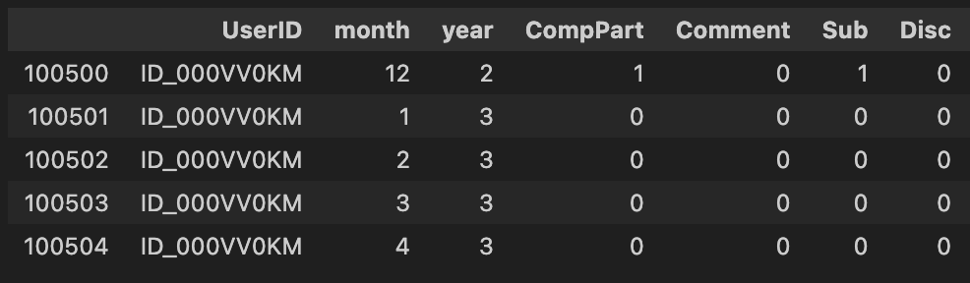
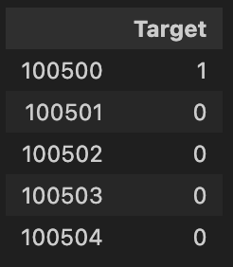
Do not adjust the width of this textbox, just type within it
Loading and data
Train
Target
Team 18

Slide 4
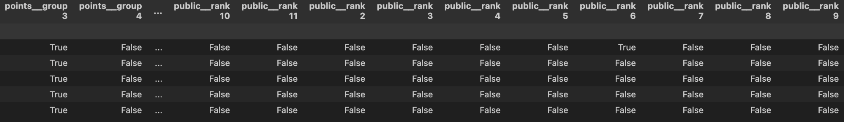
Do not adjust the width of this textbox, just type within it
Preparing the dataset
One-hot encoding:
Team 18

Slide 5
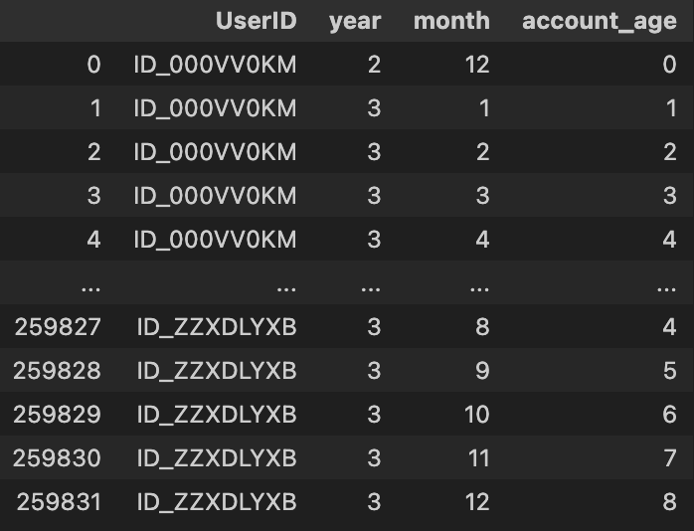
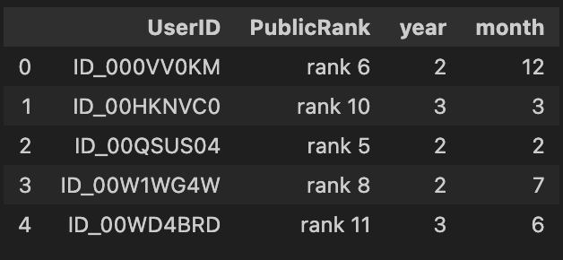
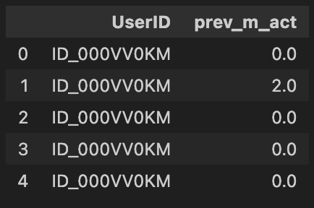
Do not adjust the width of this textbox, just type within it
Preparing the dataset
Feature generation:
‘Public rank’
‘Previous month activity’
‘Account age’
Team 18

Slide 6
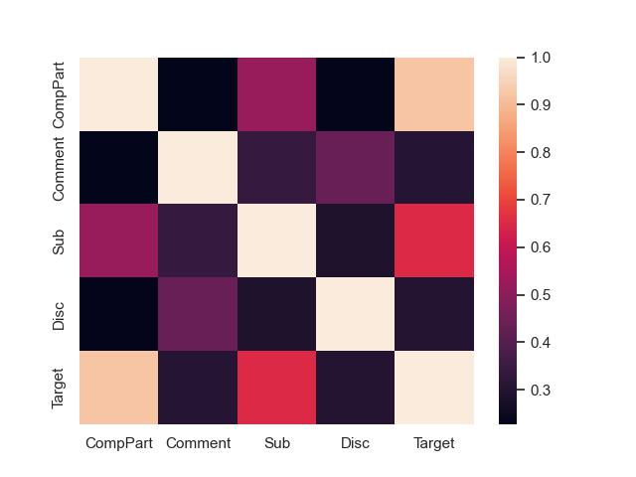
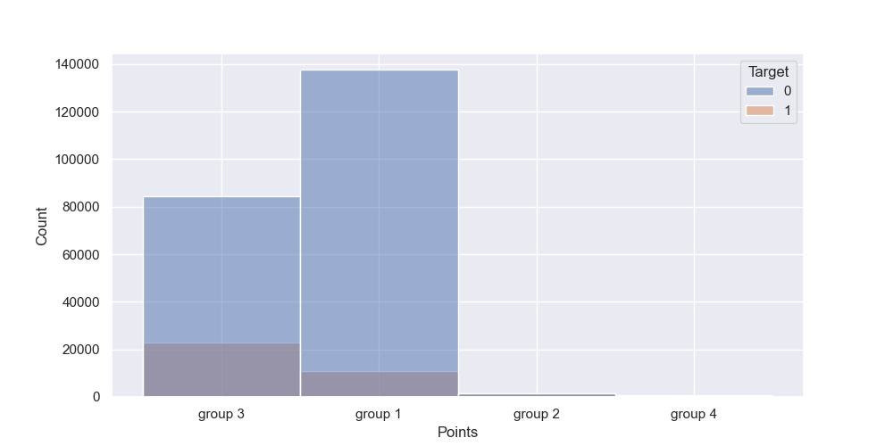
Do not adjust the width of this textbox, just type within it
Exploratory analysis
Correlation of selected features and Target
Distribution of observations among groups (by points)
Team 18

Slide 7
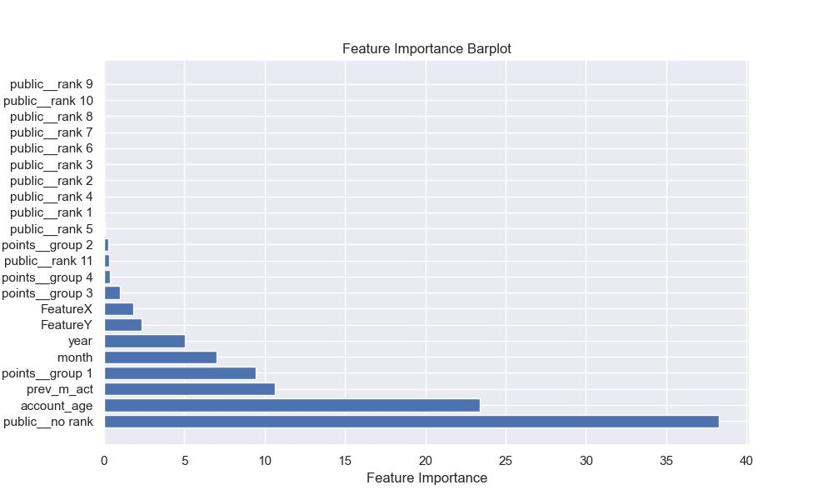
Do not adjust the width of this textbox, just type within it
Feature importance
Feature importance based on CatBoost
Team 18

Slide 8
Do not adjust the width of this textbox, just type within it
Choosing a ML model
LogReg
roc-auc: 0.819 +- 0.001
f1-score: 0.701 +- 0.001
RandomForest
roc-auc: 0.858 +- 0.002
f1-score: 0.791 +- 0.003
CatBoost
roc-auc: 0.897 +- 0.002
f1-score: 0.820 +- 0.002
Team 18

Slide 9
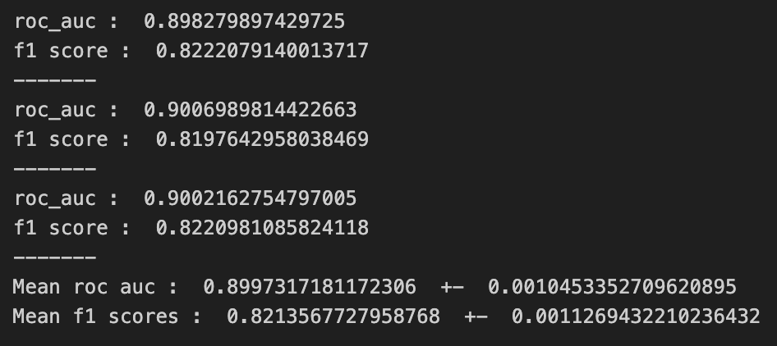
Do not adjust the width of this textbox, just type within it
Best parameters
CatBoost
depth: 8
l2_leaf_reg: 5
learning_rate: 0.03
ROC-AUC: 0.899 +- 0.001
F1-score: 0.821 +- 0.001
Metrics’ values for every model
Team 18

Slide 10
Do not adjust the width of this textbox, just type within it
Analyzing the obtained results
An interesting finding: correctness of the targets components
Used oversampling and undersampling
Conclusion: with the power of feature engineering CatBoost was the most powerful algorithm for solving our task.
Team 18

Slide 11
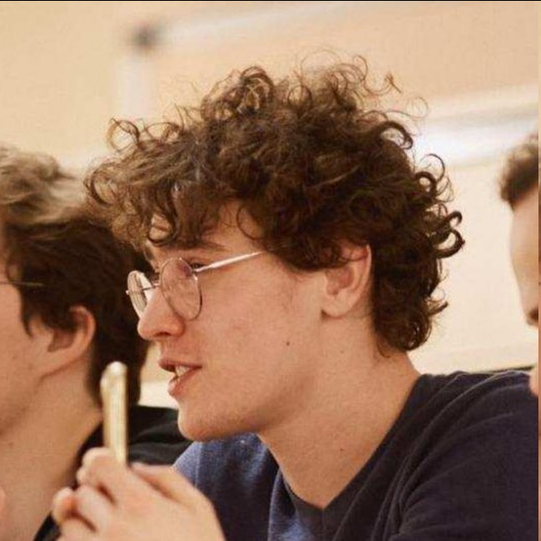

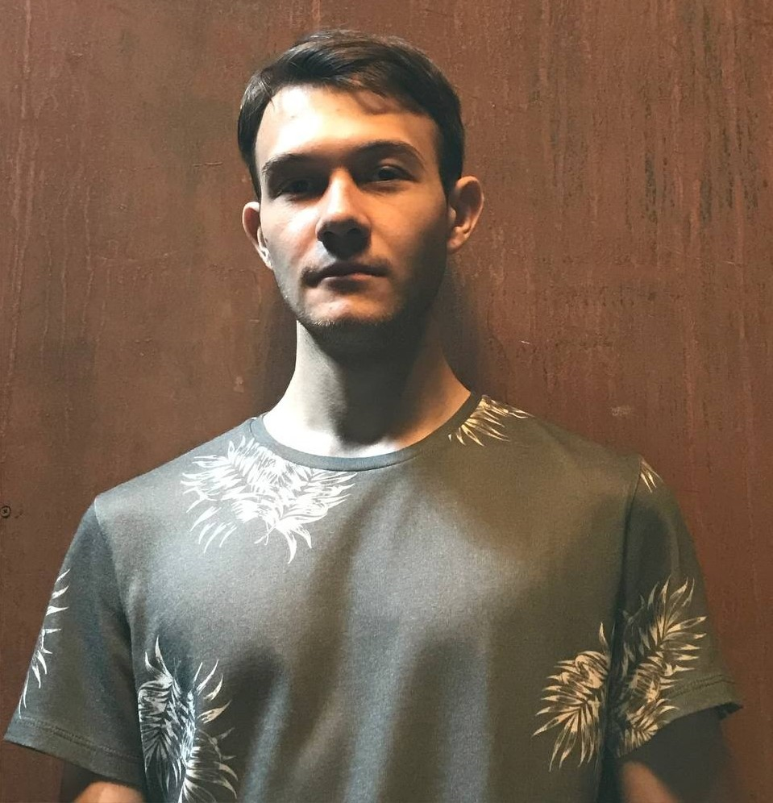
Do not adjust the width of this textbox, just type within it
Our team
Sabitov Elfat Model selection
Fokin Alex EDA
Osipenko Maksim Feature engineering
Team 18

